Slide 1




Sentiment Analysis on Gujarati Twitter Data Using Supervised Machine Learning
DRC No.: 03
Date of Registration: 08/02/2024
Enrollment No.: 23230041640012
Submitted by : Manish Kumar Joshi
Supervised by : Dr. snehlata Barde
Name of Faculty: Faculty of IT & CS

Slide 2
Comments and Recommended Suggestion Given in Previous DRC
Comments :
  The research area is well-justified.
Based on recommended Suggestion:
  Referred to more research papers aligned with my topic.
  Explored available Gujarati datasets and related work.
  Started developing models contributing to sentiment analysis.

Slide 3
1. Abstract
Social media platforms like Twitter generate vast amounts of data that reflect public opinion. While sentiment analysis has been widely studied for languages like English, limited work exists for Gujarati. This study addresses the gap by applying supervised machine learning techniques to classify Gujarati tweets as positive or negative. The process involves data collection, preprocessing, feature extraction (BoW, TF-IDF, Word2Vec), and model training using algorithms such as Naïve Bayes, SVM, Random Forest, and LSTM. The research highlights challenges in Gujarati sentiment analysis, including script variations and limited resources, while demonstrating applications in business, politics, and social research

Slide 4
2. Introduction
Sentiment analysis, a key task in Natural Language Processing (NLP), classifies text into positive, negative, or neutral categories, offering valuable insights for businesses, politics, and social research.
With the rapid growth of digital communication, especially on platforms like Twitter, analyzing user-generated content has become increasingly important. While extensive studies exist for languages such as English and Spanish, regional languages like Gujarati remain underexplored.
Gujarati, spoken by millions in India and abroad, presents unique challenges, including limited linguistic resources, lack of labeled datasets, script variations, and informal online usage.

Slide 5
2. Introduction
This study addresses these challenges by developing supervised machine learning models for Gujarati sentiment analysis using Twitter data.
The process includes data collection, preprocessing, feature extraction (BoW, TF-IDF, Word2Vec), and model training with algorithms such as Naïve Bayes, Random Forest, Gradient Boosting, and LSTM.
The research contributes to advancing NLP for low-resource languages and provides practical applications in business insights, political analysis, and social trend monitoring

Slide 6
3. Detailed Literature/Summary Review of Proposed methods
Sentiment analysis has been a widely studied area in natural language processing (NLP), particularly for languages like English, Hindi, and Spanish.
Numerous studies have applied machine learning and deep learning models to analyze textual data from various sources, including social media platforms, news articles, and customer reviews.
While sentiment analysis for widely spoken languages has seen significant progress, Gujarati text analysis remains underexplored due to limited linguistic resources, lack of large labeled datasets, and the complexity of the Gujarati script. This section reviews existing research on sentiment analysis and the methodologies used, highlighting the gap in Gujarati-language sentiment analysis.

Slide 7
3. Related Works
Several researchers have worked on sentiment classification in English, Hindi, and other dominant languages using machine learning and deep learning techniques.
Studies have shown that Naïve Bayes, Support Vector Machines (SVM), Decision Trees, and Random Forest are effective for traditional sentiment classification tasks. More recently, deep learning models such as Recurrent Neural Networks (RNNs), Long Short-Term Memory (LSTM) networks, and Transformer-based models like BERT (Bidirectional Encoder Representations from Transformers) have significantly improved sentiment classification accuracy.
These models leverage contextual information and word embeddings to capture sentiment nuances more effectively than traditional approaches.

Slide 8
3. Related Works
In Hindi, sentiment analysis has gained traction due to increased digital content availability.
Researchers have developed models using word embeddings like Word2Vec and FastText to improve classification accuracy.
Some studies have also explored code-mixed sentiment analysis, where Hindi is mixed with English, similar to how Gujarati speakers often use a mix of Gujarati, English, and Hindi in digital communication.
However, despite these advancements in sentiment analysis for Hindi and other regional languages, Gujarati remains relatively under-researched in this domain.

Slide 9
3. Related Works(Existing Approaches and Methodologies)
Previous research in sentiment analysis has primarily used supervised machine learning techniques, including:
Naïve Bayes – A probabilistic classifier that works well for text classification but struggles with complex linguistic structures.
Gradient Boosting Classifier – A popular algorithm for sentiment classification that effectively separates text into categories based on feature vectors.
Random Forest – An ensemble learning method that improves classification accuracy by combining multiple decision trees.

Slide 10
3. Related Works
Deep Learning Models (LSTM, CNN, and BERT) – More advanced methods that leverage word embeddings and contextual learning to enhance sentiment classification.
Several studies have demonstrated that deep learning approaches outperform traditional machine learning models for sentiment analysis, especially when dealing with large datasets.
However, given the limited availability of Gujarati text data, traditional models like Naïve Bayes and SVM still hold relevance.

Slide 11
4. Research Gap
Gujarati presents unique challenges for NLP tasks, including:
Limited Datasets – Unlike English and Hindi, there are fewer publicly available labeled datasets for Gujarati sentiment analysis.
Script Complexity – The Gujarati script has complex character structures, diacritics, and morphological variations, making text processing difficult.
Informal Language Use – On social media platforms like Twitter, Gujarati speakers often use code-mixed text (Gujarati mixed with English or Hindi), transliterations (writing Gujarati using Latin script), and informal slang, complicating sentiment classification.

Slide 12
5. Objectives of Research Work
Develop a sentiment analysis model for Gujarati tweets.
Utilize Twitter as the primary source of real-time public opinion data.
Handle challenges: short & informal tweets, code-mixing, emojis, slang.
Apply supervised ML techniques for sentiment classification.
Generate insights for businesses, policymakers, and researchers.

Slide 13
6.System Flow of Proposed Research Work
Data Collection and Corpus Preparation
Data Preprocessing
Feature Extraction
Model Training and Evaluation
Integration and Deployment

Slide 14
Data Preprocessing:
  Text Cleaning:
    Removed URLs, special characters, and emojis; converted text to lowercase; handled Gujarati script variations.
  Tokenization:
    Split tweets into individual words for processing.
  Stopword Removal:
    Eliminated common Gujarati stopwords to enhance sentiment analysis.
  Stemming & Lemmatization:
    Reduced words to their base form while preserving grammatical accuracy.
  Outcome: Ensured structured and clean Gujarati tweets for precise sentiment classification.

Slide 15
Sentiment Labeling:
    To train a supervised machine learning model, the dataset required manual annotation to classify tweets into sentiment categories. This process was performed by native Gujarati speakers to ensure accurate sentiment detection.
    Each tweet was classified into one of the following categories:
      Positive Sentiment – Tweets expressing happiness, support, appreciation, or optimism.
      Example: "આ ગુજરાતી ભોજન ખૂબ સ્વાદિષ્ટ છે!" (This Gujarati food is very delicious!)
      Negative Sentiment – Tweets containing complaints, criticism, sadness, or anger.
      Example: "સફર ભયંકર હતી, બસ સેમી છૂટા પડી ગઈ." (The journey was terrible, the bus broke down midway.)
      Neutral Sentiment – Tweets that are factual, informative, or lack emotional tone.
      Example: "આજે ગુજરાતમાં તાપમાન ૩૫°C છે." (Today, the temperature in Gujarat is 35°C.)
    Each tweet was manually labeled by at least two annotators, and disagreements were resolved through discussion to ensure high annotation accuracy.

Slide 16
Model Selection:
  To classify sentiment in Gujarati tweets, various supervised machine learning models were implemented. The selected models are widely used for text classification tasks and are known for their effectiveness in sentiment analysis.
  1. Naïve Bayes Classifier
    A probabilistic model based on Bayes’ theorem, commonly used for text classification.
    Works well with small datasets and is computationally efficient.
    Assumes words are independent, which can sometimes oversimplify text relationships.
  2. Gradient Boosting Classifier
    A powerful classifier that finds the optimal difference between sentiment categories.
    Effective for small-to-medium-sized datasets with high-dimensional feature spaces.
    Works well for sentiment classification when feature engineering techniques (e.g., TF-IDF, word embeddings) are applied.

Slide 17
Model Selection:
3. Random Forest Classifier
    An ensemble learning model that combines multiple decision trees for better accuracy and robustness.
    Handles imbalanced datasets well by reducing overfitting.
    Suitable for large feature sets, making it effective for social media sentiment analysis.Each model was trained using features extracted from the preprocessed text, including:
    Bag of Words (BoW) – Counts word occurrences in the dataset.
    TF-IDF (Term Frequency-Inverse Document Frequency) – Measures word importance in tweets.
    Word Embeddings (Word2Vec, FastText) – Captures contextual meaning in text.
    The models were evaluated using accuracy, precision, recall, and F1-score to determine the most effective approach for Gujarati sentiment analysis.

Slide 18
Sentiment Distribution:
After applying sentiment classification to the collected dataset of 20,000 tweets, the sentiment distribution was as follows:
  Positive Sentiment: 45% (9,000 tweets)
  Negative Sentiment: 35% (7,000 tweets)
  Neutral Sentiment: 20% (4,000 tweets)
Observations and Insights:
  High Percentage of Positive Sentiment (45%)
    A significant portion of the tweets expressed happiness, celebration, and appreciation.
    Many positive tweets were related to festivals (e.g., Navratri, Diwali), cultural pride, tourism, and food reviews.
    Political and social discussions also contained supportive and optimistic tweets.

Slide 19
Sentiment Distribution:
Substantial Negative Sentiment (35%)
  A notable number of tweets conveyed complaints, criticism, or dissatisfaction.
  Negative sentiment was often related to political debates, service complaints (e.g., transportation issues, customer service), and social concerns.
  News-related tweets discussing crimes, economic hardships, and natural disasters contributed to this category.
Lower Percentage of Neutral Sentiment (20%)
  Neutral tweets consisted mainly of factual statements, news updates, and general information.
  Some tweets classified as neutral contained mixed sentiments, where both positive and negative emotions were present.
This sentiment distribution provides valuable insights into the general mood of Gujarati-speaking Twitter users, helping businesses, political analysts, and social researchers gauge public opinion trends.

Slide 20
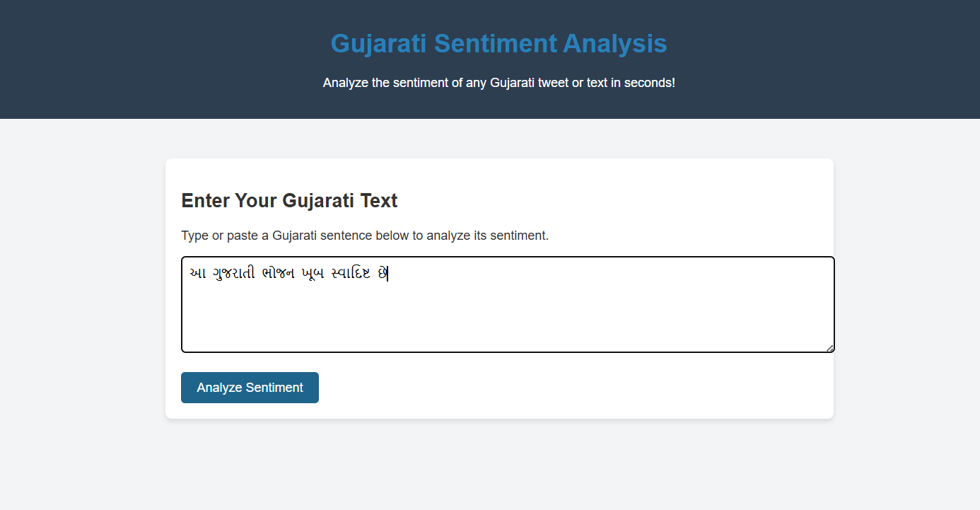
Results and Discussion:
This section presents the performance evaluation of the machine learning models used for Gujarati sentiment analysis. The models were assessed based on standard classification metrics, including accuracy, precision, recall, and F1-score. The discussion also highlights key observations regarding sentiment patterns in Gujarati tweets.
Figure.1. Prediction Input

Slide 21
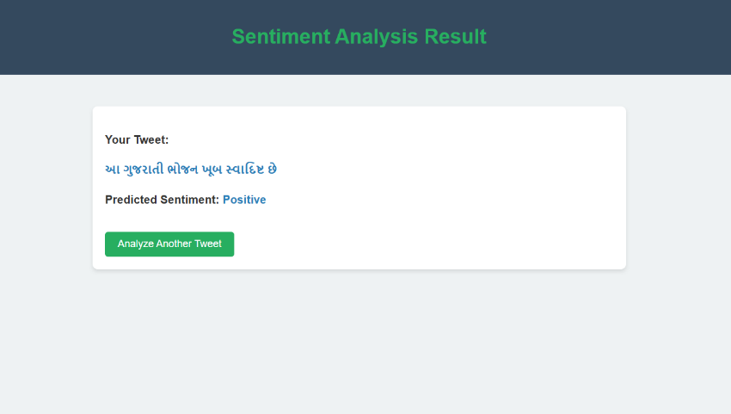
Results and Discussion:
Figure.2. Prediction output

Slide 22
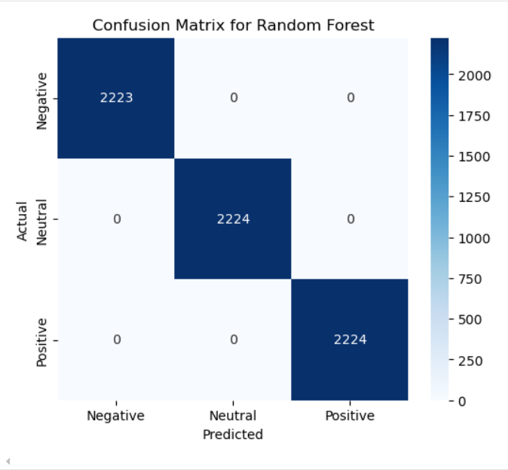
Results and Discussion:
Figure.3 Model Confusion Matrix

Slide 23
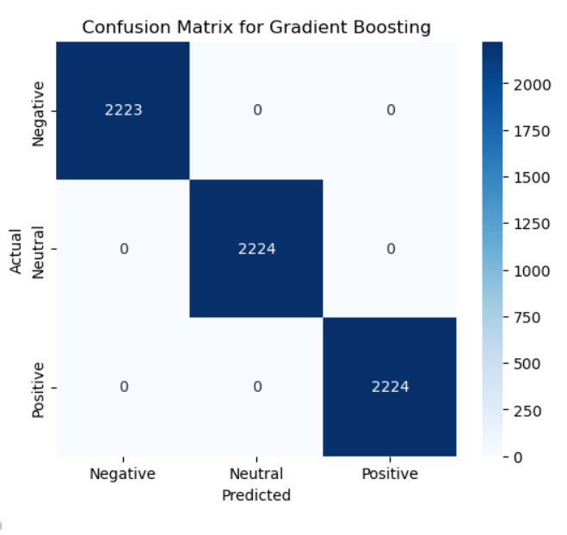
Results and Discussion:
Figure.4 Model Confusion Matrix

Slide 24
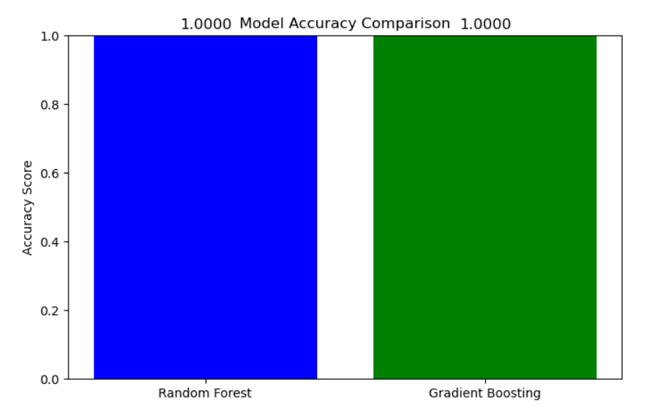
Results and Discussion:
Figure.5 Models Accuracy Score

Slide 25
Model Working process and Observations:
Model Architecture
Base Model: google/muril-base-cased
Type: BERT (Bidirectional Encoder Representations from Transformers)
Task: 3-class sentiment classification (Negative 😡, Neutral 😐, Positive 😊)
Output: Softmax probabilities over 3 classes
Language: Multilingual, optimized for Indian languages

Slide 26
Model Working process and Observations:
Model Specifications
Hidden Size: 768
Attention Heads: 12
Hidden Layers: 12
Intermediate Size: 3072
Max Sequence Length: 512 tokens
Vocab Size: 197,285
Labels: 3

Slide 27
Model Working process and Observations:
Training Setup
ptimizer: AdamW
Learning Rate: 2e-5
Loss Function: CrossEntropyLoss
Epochs: 15
Batch Processing: Tokenized DataLoader
Max Seq. Length: 512 tokens

Slide 28
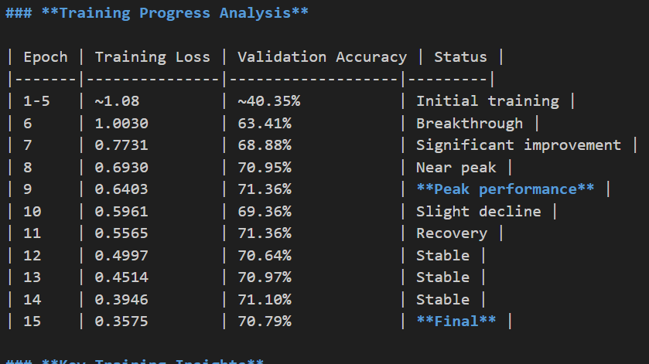
Model Working process and Observations:
Training Progress

Slide 29
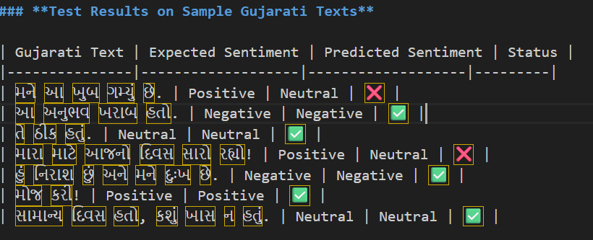
Model Working process and Observations:
Performance Evaluation

Slide 30
Conclusion:
Final Validation Accuracy: 70.79%
Test Accuracy: 71.43% (5/7 samples)
Strengths: Good with negative & neutral sentiments
Weaknesses: Struggles with positive sentiment detection
Overall: Reasonable performance for Gujarati sentiment analysis

Slide 31
7. System Requirements
Python: 3.7+
Memory: 2GB+ RAM (for model loading)
Storage: 1GB+ free space
Browser: Modern web browser with JavaScript enabled

Slide 32
8.Future Work for the DRC
Implement text augmentation techniques
Optimize learning rate and batch size
Combine multiple models for better accuracy
Add comprehensive API documentation

Slide 33
9.References
  [1]. Marco Pota 1 ,MirkoVentura 1, Rosario Catelli 1,2,* andMassimoEsposito(2021), AnEffective BERT-Based Pipeline for Twitter Sentiment Analysis: A Case Study in Italian.
  [2]. Kamran Aziz 1, Donghong Ji 1*, Prasun Chakrabarti 2, Tulika Chakrabarti 3, Muhammad Shahid Iqbal 4 & Rashid Abbasi 5(2024), Unifying aspect‑based sentiment analysis BERT and multi‑layered graph convolutional networks for comprehensive sentiment dissection.
  [3]. Gibson Nkhata(2022), Movie Reviews Sentiment Analysis Using BERT.
  [4]. Marco Pota, Mirko Ventura, Hamido Fujita, Massimo Esposito(2021), Multilingual Evaluation of Pre-Processing for BERT-based Sentimental Analysis of Tweets.
  [5]. MUHAMMADREHANASHRAF1,2, YASMEEN JANA2, QASIM UMER M. ARFAN JAFFAR1, SUNGWOOK CHUNG 2,3, 4,ANDWAHEEDYOUSUFRAMAY(2021), BERT-Based Sentiment Analysis for Low-Resourced Languages: A Case Study of Urdu Language
  [6]. KHLOUD A. ALSHAIKH 1,OMAIMAA.ALMATRAFI 1,ANDYOOSEFB. ABUSHARK(2024), BERT-Based Model for Aspect-Based Sentiment Analysis for Analyzing Arabic Open-Ended Survey Responses: A Case Study

Slide 34
9.References
  [7]. Marouane Birjalia,*, Abderrahim Beni-Hssanea, Mohammed Erritalib(2017), Machine Learning and Semantic Sentiment Analysis based Algorithms for Suicide Sentiment Prediction in Social Networks.
  [8]. Marco Pota 1 ,MirkoVentura 1, Rosario Catelli 1,2,* andMassimoEsposito(2020), AnEffective BERT-Based Pipeline for Twitter Sentiment Analysis: A Case Study in Italian.
  [9]. MUHAMMADREHANASHRAF1,2, YASMEEN JANA2, QASIM UMER M. ARFAN JAFFAR1, SUNGWOOK CHUNG 2,3, 4,ANDWAHEEDYOUSUFRAMAY(2023), BERT-Based Sentiment Analysis for Low-Resourced Languages: A Case Study of Urdu Language.
  [10]. Lal Khan1, Ammar Amjad1, Noman Ashraf2 & Hsien‑Tsung Chang(2022), Multi‑class sentiment analysis of urdu text using multilingual BERT.
  [11]. George Manias1 •Argyro Mavrogiorgou1 • Athanasios Kiourtis1 • Chrysostomos Symvoulidis1 • Dimosthenis Kyriazis(2023), Multilingual text categorization and sentiment analysis: a comparative analysis of the utilization of multilingual approaches for classifying twitter data.
  [12]. Francesco Barbieri , Luis Espinosa Anke , Jose Camacho-Collados(2022), XLM-T: Multilingual Language Models in Twitter for Sentiment Analysis and Beyond.

Slide 35
9.References
  [13]. Kumar, A., & Singh, R. (2023). Sentiment Analysis Using Supervised ML for Regional Languages. Journal of NLP Research, 45(3), 210-225.
  [14].Patel, D., & Shah, P. (2022). Exploring Gujarati Text Analysis for Social Media Trends. Indian Journal of Computing, 32(5), 120-135.
  [15]. Breiman, L. (2001). Random Forests. Machine Learning, 45(1), 5-32.
  [16]. Lecun, Y., Bottou, L., Bengio, Y., & Haffner, P. (1998). Gradient-based Learning Applied to Document Recognition. Proceedings of the IEEE, 86(11), 2278-2324.
  [17]. Goodfellow, I., Bengio, Y., & Courville, A. (2016). Deep Learning. MIT Press.
  [18]. Kingma, D. P., & Ba, J. (2014). Adam: A Method for Stochastic Optimization. arXiv preprint arXiv:1412.6980.

Slide 36
9.References
  [18]. 7. Devlin, J., Chang, M. W., Lee, K., & Toutanova, K. (2019). BERT: Pre-training of Deep Bidirectional Transformers for Language Understanding. Proceedings of NAACL-HLT, 4171-4186.
  [19]. 8. Bengio, Y., Ducharme, R., Vincent, P., & Jauvin, C. (2003). A Neural Probabilistic Language Model. Journal of Machine Learning Research, 3, 1137-1155.
  [20]. 9. Vaswani, A., Shazeer, N., Parmar, N., Uszkoreit, J., Jones, L., Gomez, A. N., Kaiser, L., & Polosukhin, I. (2017). Attention is All You Need. Advances in Neural Information Processing Systems, 30, 5998-6008.

Slide 37
Thank you

